Slide 1
Opportunity Analysis of a major Food & Beverages
Manufacturer
- Vinay H

Slide 2
Case Statements
To get a quick view of share of F&B spends from existing customers (restaurants) that Shaun’s
company is getting, and to analyze if there are any opportunities in the specific segments.
To analyze the adjacent opportunities from the non-commercial establishments to additionally
sell into (note that there are no customers currently in the non-commercial segment).
Retailers are a different business division and hence out of scope for Shaun, but some of
Shaun’s customers / prospects could be buying from these retailers – so getting a view of retailer
presence adjacent to Shaun’s customers & prospects will help understand how much of these
opportunities are being met / unmet.

Slide 3
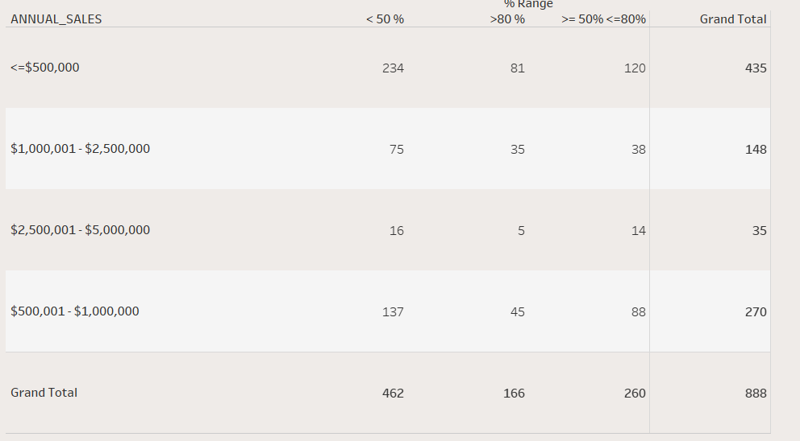
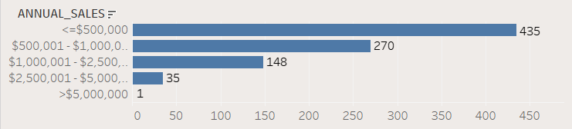
Analysis of Restaurants’ Annual sales and % share of F&B
purchases from Shaun's Company
Inferences: -
Here we have analyzed the restaurants’ % F&B share from their Annual Sales Figures. We have bifurcated the % F&B share in 3 segments such that we can have a clarity on which segments of the restaurants Shaun needs to focus more on.
There are total 889 restaurants, out of which 462 are the ones which have < 50 % of the F&B share and needs to focused more so as to increase the business, 261 are the ones with >= 50 % and <= 80 % of F&B share which are doing well but needs a tinge of attention from Shaun and lastly the 166 are ones who have > 80 % of the F&B share which basically indicates that Shaun has a great business understanding with these customers and needs to just maintain a strong business relations with them.

Slide 4
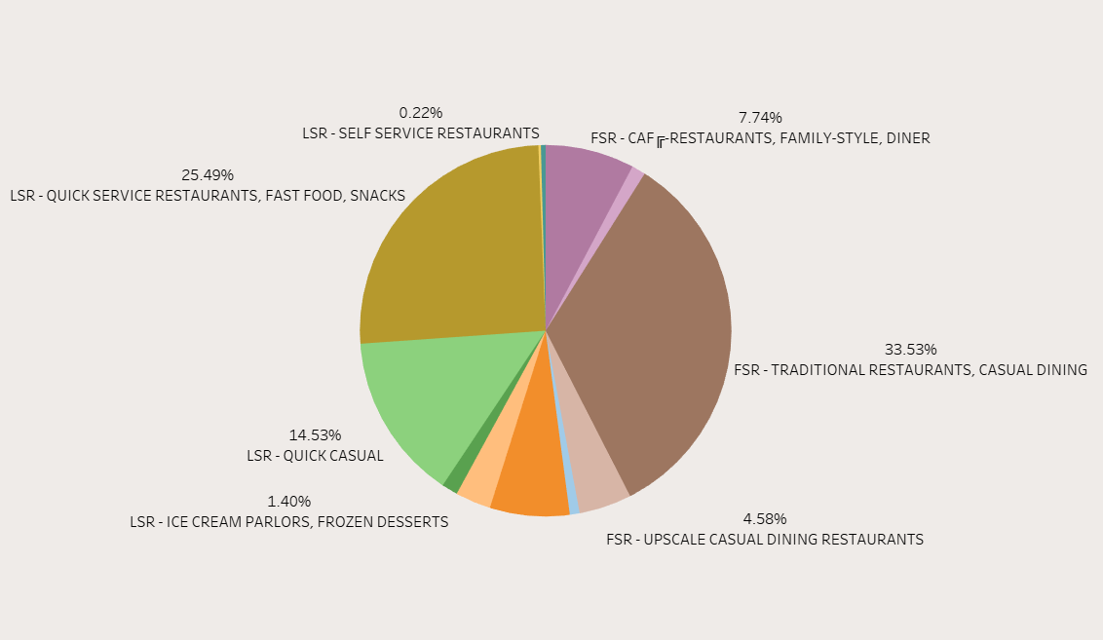
% Share of F&B purchases from company across different Market Segments
Inferences: -
Here we have analyzed the % Share of F&B purchases from the company across different Market Segments like FSR (Full Service Restaurants) and LSR (Limited Service Restaurants) which are further segmented in different categories.
The basic purpose of performing Pie Chart analysis was to show % Share of F&B purchases of different type of ‘Restaurant Services’.
Shaun needs to focus more on the restaurants that have < 10 % (FSR and LSR combined) of the % Share thereby which he can expand his business accordingly.

Slide 5
Analysis of different segment of company’s products across the restaurants.
Inferences: -
Here we have analyzed different types of products and their position in the % Share bracket of the restaurants.
Please find the Line and Stacked Column Graph attached in the next slide
Here we compared two products each on the graph. Dry and Fresh products & Frozen and Protein Products.
As you can see from the first graph that Dry and Fresh Products majorly constitutes in the < 50 % Share category and are performing above average in the >= 50 % and <= 80 % category but at the same time are performing at par in the > 80 % bracket. Shaun needs to look after the restaurants falling under > 80 % bracket and needs to improve his business wrt his Dry and Fresh Products.
Similarly for Frozen and Protein Products, these products are performing average throughout the % Share brackets and needs to be look upon.

Slide 6
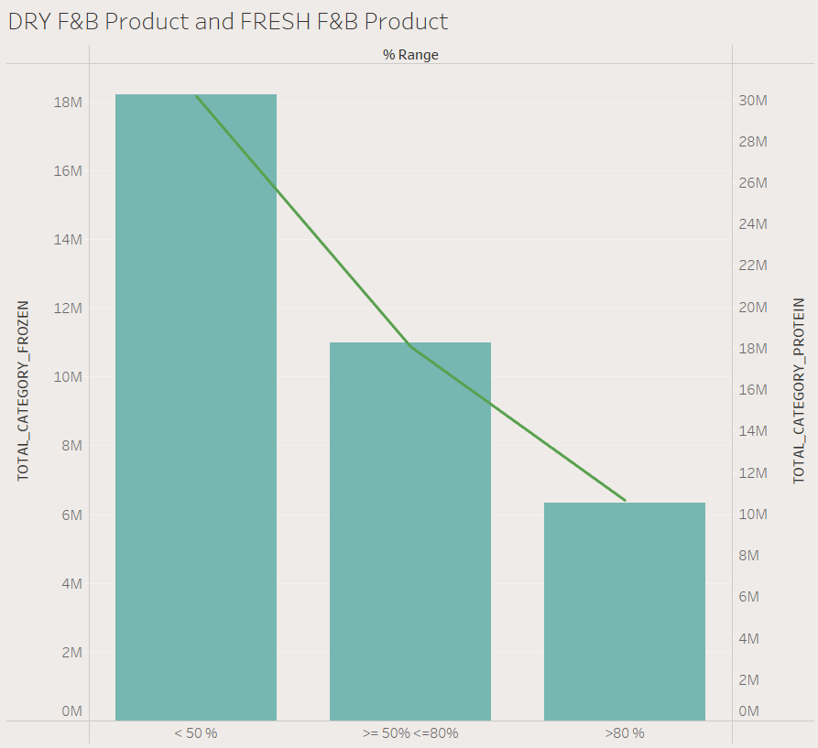
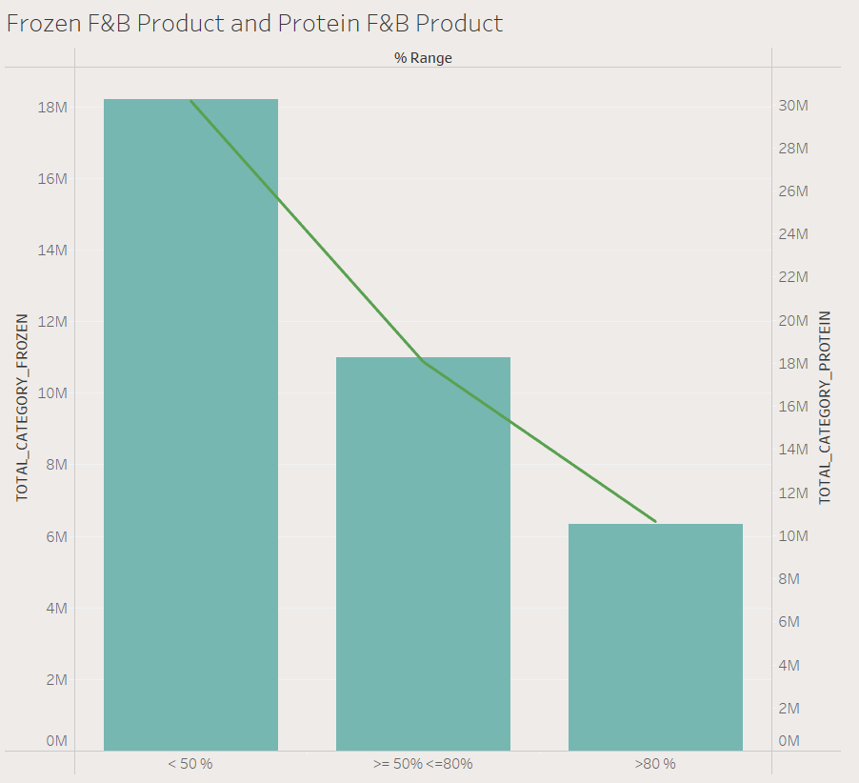

Slide 7
Analysis for the Non – Commercial potential Establishements.
Inference: -
Here we have analysed the potential of the Non – Commercial Customers / Establishments to purchase Shaun’s F&B products.
Please find the attached 3 tables (matrices) in the next slide which basically shows you the data of Non – Commercial customers with respect to their Market Segments and the Number of Meals served per day.
First graph shows you the overall Count and Percentage of the Non – Commercial Customers and their market presence. Higher the Count / Percentage, higher the chances of Market Penetration. As we can see Nursing Homes and Other Healthcare Establishments constitutes of nearly 35.60 % of overall Non – Commercial Customers. Shaun needs to establish a communication channel with these customers and needs to have a marketing strategy amongst these establishments. Word of mouth could be spread amongst these segments by the already existing customers. Similarly the second table shows the data of Number of Meals served per day and the Count and Percentage of the Non – Commercial Customers. There are nearly 43.30 % of Non – Commercial Customers who served 1000 – 2000 and > 2000 meals per day which is a massive number. This can fuel the company’s business if correct strategies are applied in acquiring these establishments. Also Shaun also needs to focus on the establishments which are catering to < 1000 meals per day for a substantial growth of his business.

Slide 8
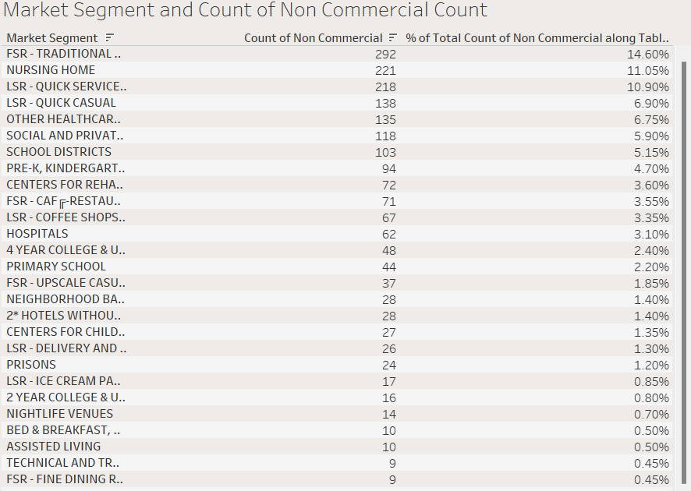
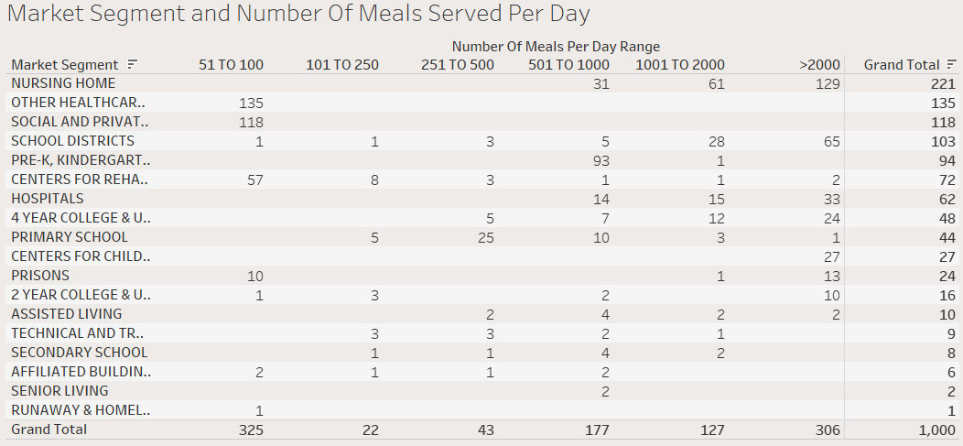

Slide 9
Analysis for Retailers of the Customers.
Inference: -
Here we have analysed % Share of F&B products amongst the Retailers across different Market Segments.
Please find the attached tables in the next slides which basically shows you the data of Retailers with respect to their Market Segments and Annual Sales.
In first table we have analysed different Market Segments across the Retailers with respect to their Annual Sales. Here Annual Sales are bifurcated into 6 segments. <= $500000 segment has the maximum number of Retailers (37 % approx.). Shaun needs to focus on the Retailers falling under this segment and $100000 - $500000 segment in order to leverage his business amongst the Retailers. Along with these segments Shaun also needs to look after the segments which caters to Low Annual Sales such that it can create a chain of Retailers amongst the Small Retailers with Low Annual Sales.
The second graph shows you the Total Units purchased by the Retailers amongst the different Market Segments. Grocery Store Segment did purchase 513 units which constitutes of more than 50% of the Total Units. Shaun must maintain his business relations with the Grocery Stores and should focus more on the other segments like Fish and Seafood Market and Meat Market etc.

Slide 10
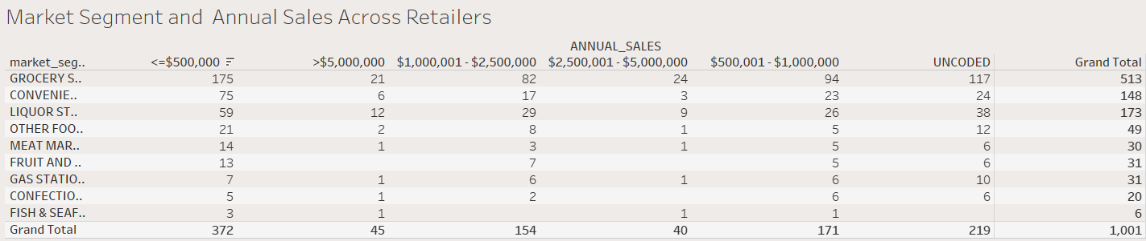
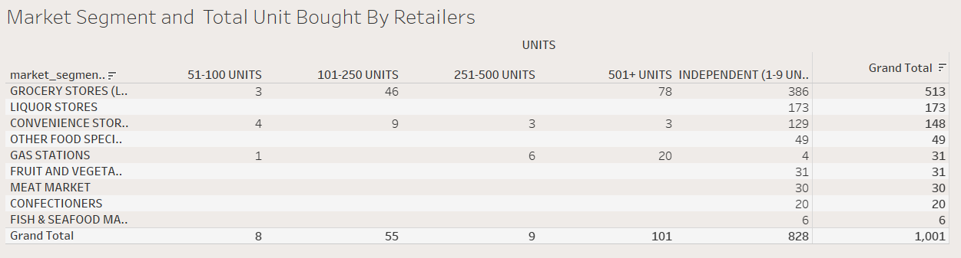

Slide 11
Feedback / Recommendations
Recommendations for % Share of F&B purchases: -
Shaun needs to improve his % Share with the customers with <= $500000 Annual Sales.
As of now there is only one restaurant in the > $500000 segment, this segment has a huge potential to leverage Shaun’s business. In order to attract more customers Shaun needs to come up with a good Marketing Plan and a great Business Model.
There are some customers whose data isn’t available. If the data is found Shaun can convert those prospects into his customers.
Recommendations for Non – Commercial Establishments: -
Shaun needs to have a legit Marketing Plan and Business Model to convert these Non – Commercial Establishments into his customers.
Most of the Non – Commercial Establishments consist of Hospitals, Schools, Healthcare Centers etc. Shaun must provide his service to them at an utmost discounted price in order to convert them into his regular customers and to penetrate his business in this market.

Slide 12
Recommendations for Retailers: -
Shaun must try to acquire the Retailers trust and try to bring them under one roof in order to improve his business amongst them.
Shaun must invest in Marketing / Advertising of his products in order to penetrate the Retailers Market. Word of Mouth Publicity, Newspaper ads, Facebook ads etc. can be used by Shaun.
Shaun must provide discounts to the Retailers in order to acquire them and to expand his business amongst them.
If possible Shaun can also create a portal / website/ app for them in order to have smooth interface of communication amongst them

Slide 13


